Slide 1
Stack and Queue

Slide 2
Stacks and Queues
A stack is a last in, first out (LIFO) data structure
Items are removed from a stack in the reverse order from the way they were inserted
A queue is a first in, first out (FIFO) data structure  Items are removed from a queue in the same order as they were inserted

Slide 3
STACK

Slide 4
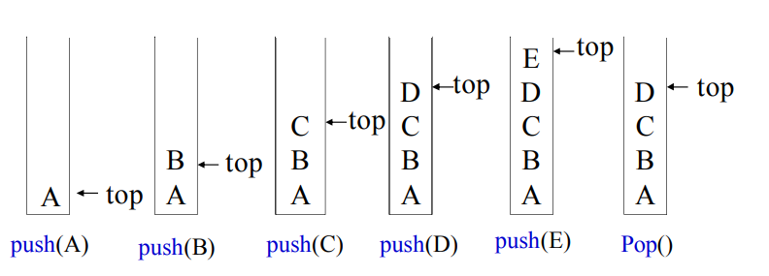
Stack
A stack is a list with the restriction that insertions and deletions can be performed in only one position, namely, the top of the stack.
The operations: push (insert) and pop (delete)

Slide 5
Stack
A stack is a list with the restriction that insertions and deletions can be performed in only one position, namely, the top of the stack.
The operations: push (insert) and pop (delete)

Slide 6
Stack
Show the status of a STACK implemented by an array of size, m=5 for the operations:
push(10), push(20), pop(), push(30), push(40), pop(), pop(), pop().

Slide 7
Applications of Stack
Direct applications
Page-visited history in a Web browser
Undo sequence in a text editor
Saving local variables when one function calls another, and this one calls another, and so on. 
Indirect applications
Auxiliary data structure for algorithms
Component of other data structures

Slide 8
Array Implementation of Stacks
To implement a stack, items are inserted and removed at the same end (called the top)
To use an array to implement a stack, you need both the array itself and an integer
The integer tells you either:
Which location is currently the top of the stack, or
How many elements are in the stack

Slide 9
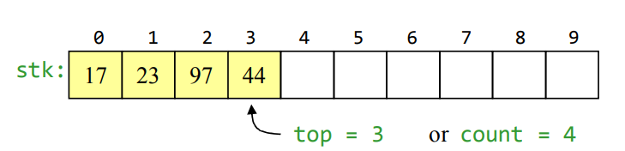
Array Implementation of Stacks
The functions after being called, will look like this:
Push(44);
X=Pop();

Slide 10
Stacks by Array: Push and Pop
If the bottom of the stack is at location 0, then an empty stack is represented by top = -1 or count = 0
To add (push) an element, either:
Increment top and store the element in stk[top], or
Store the element in stk[count] and increment count
To remove (pop) an element, either:
Get the element from stk[top] and decrement top, or
Decrement count and get the element in stk[count]

Slide 11
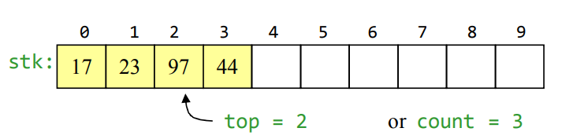
Stacks by Array: After Popping
When you pop an element, do you just leave the “deleted” element sitting in the array?
The surprising answer is, “it depends”
If this is an array of primitives, then doing anything more is just a waste of time
If the array contains objects, you should set the delete array element to null

Slide 12
Stacks by Array: Error Checking
There are two stack errors that can occur:
Underflow: trying to pop (or peek at) an empty stack
Overflow: trying to push onto an already full stack
For underflow, you should check whether the stack is empty or not
Use if condition
For overflow, you could do the same thing
Or, you could copy everything into a new, larger array

Slide 13
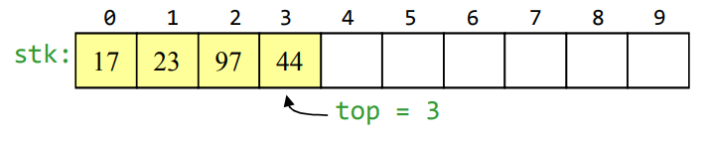
Let us write the Code for Stack

Slide 14
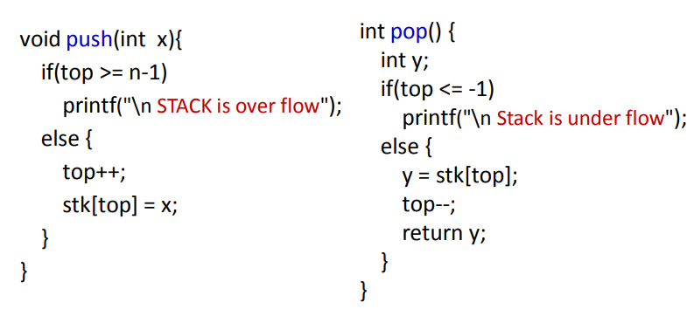
Let us write the Code for Stack

Slide 15
Linked List Implementation of Stacks
With a linked-list representation, overflow will not happen (unless you exhaust memory, which is another kind of problem)
Underflow can happen, and should be handled the same way as for an array implementation

Slide 16
Let us write the code for SLL : Push

Slide 17
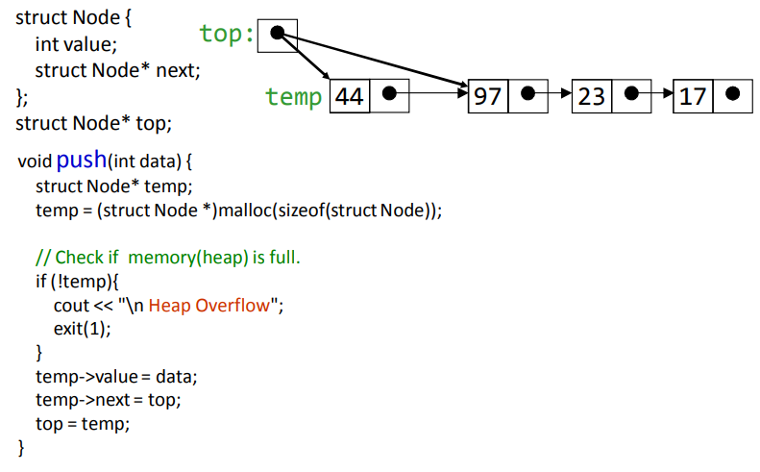
Let us write the code for SLL : Push

Slide 18
Let us write the code for SLL : Pop

Slide 19
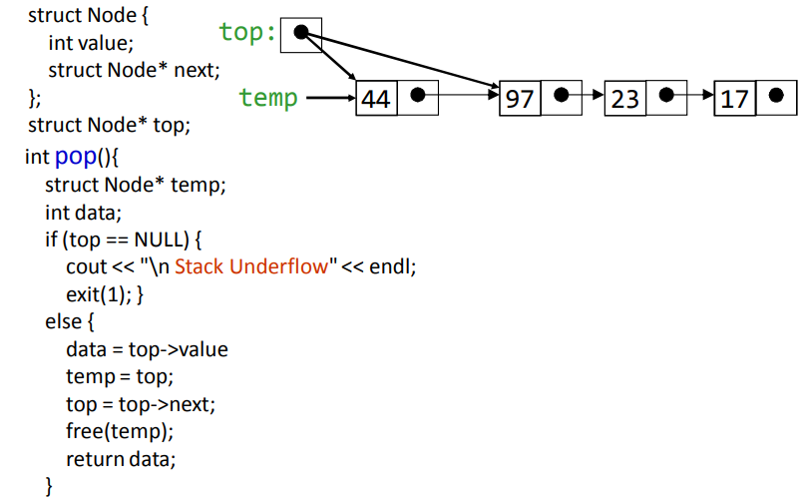

Let us write the code for SLL : Pop

Slide 20
QUEUE

Slide 21
Queue: First In First Out
A Queue is an ordered collection of items from which items may be removed at one end (called the front of the queue) and into which items may be inserted at the other end (the rear of the queue).
The operations: enqueue (insert) and dequeue (delete)

Slide 22

Queue: First In First Out
A Queue is an ordered collection of items from which items may be removed at one end (called the front of the queue) and into which items may be inserted at the other end (the rear of the queue).
The operations: enqueue (insert) and dequeue (delete)

Slide 23
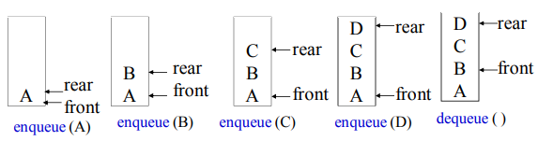
Queue: First In First Out
A Queue is an ordered collection of items from which items may be removed at one end (called the front of the queue) and into which items may be inserted at the other end (the rear of the queue).
The operations: enqueue (insert) and dequeue (delete)

Slide 24
Queue: First In First Out
A Queue is an ordered collection of items from which items may be removed at one end (called the front of the queue) and into which items may be inserted at the other end (the rear of the queue).
The operations: enqueue (insert) and dequeue (delete)

Slide 25
Queue: First In First Out
Application of Queues
Direct applications
Waiting lists, bureaucracy
Access to shared resources (e.g., printer)
Multiprogramming
Indirect applications
Auxiliary data structure for algorithms
Component of other data structures

Slide 26
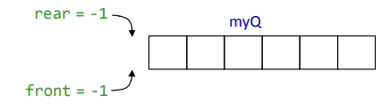
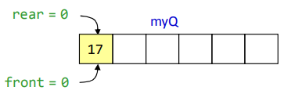
Array Implementation of Queue
Initial Queue, that is Empty Queue
After inserting 1st element in an Empty Queue, Set front = rear = 0

Slide 27
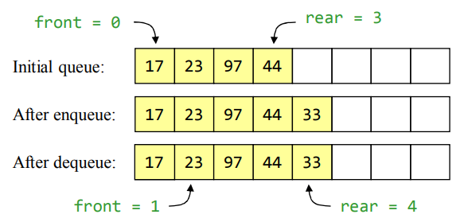
Array Implementation of Queues

Slide 28
Array Implementation of Queues
Notice how the array contents “crawl” to the right as elements are enqueued and dequeued
This will be a problem after a while!

Slide 29
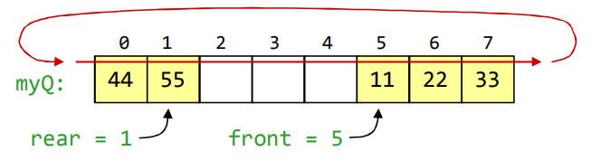
Circular Queues using Arrays
We can treat the array holding the queue elements as circular (joined at the ends)
The previous elements were deleted
Elements were added to this queue in the order 11, 22, 33, 44, 55, and will be removed in the same order
Use: front = (front + 1) % Qsize; and: rear = (rear + 1) % Qsize;

Slide 30
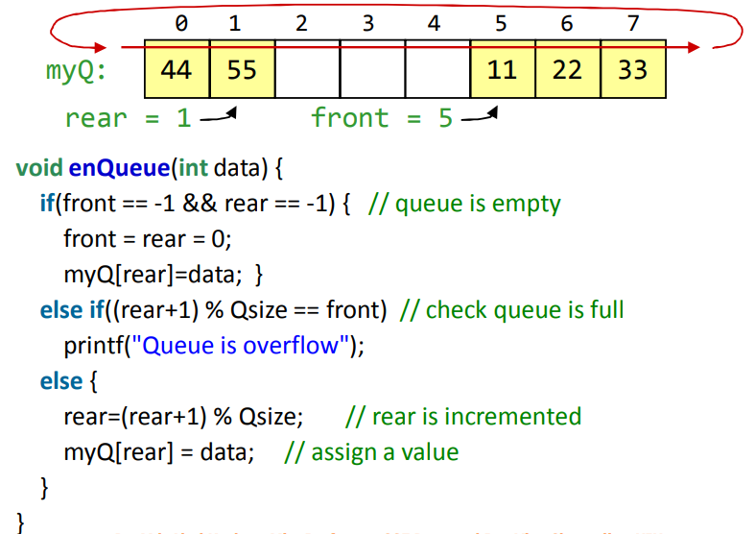
Circular Queues using Arrays: Enqueue()

Slide 31
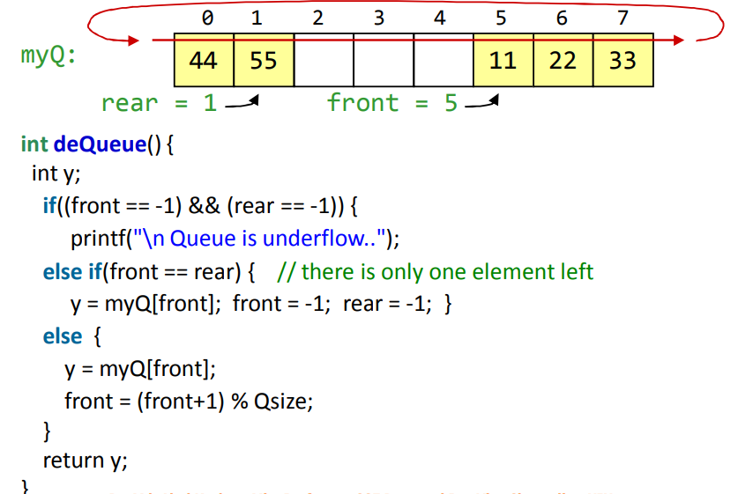
Circular Queues using Arrays: Dequeue()

Slide 32
Linked List Implementation of Queues
In a queue, insertions occur at one end (rear end), deletions at the other end (front end).
Operations at the head of a singly-linked list (SLL) are O(1), but at the other end they are O(n)
Because you have to find the last element each time
BUT: there is a simple way to use a singly-linked list to implement both insertions and deletions in O(1) time
You always need a pointer to the first element in the list
You can keep an additional pointer to the last element in the list

Slide 33
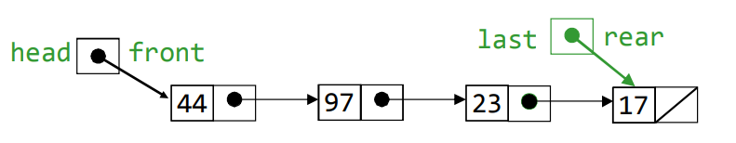
Linked List Implementation of Queues

Slide 34
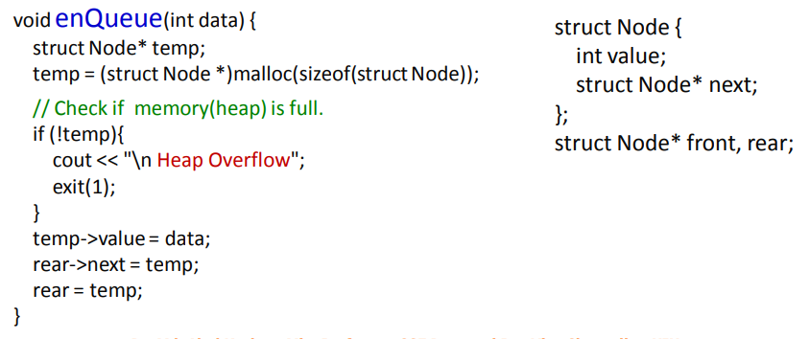
Enqueue (Insertion at the End)

Slide 35
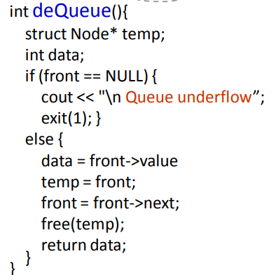
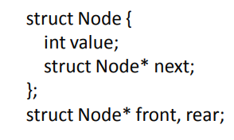
Dequeue (Deletion at the head and returning)

Slide 36
Queue Implementation Details
With an array implementation:
you can have both overflow and underflow
With a linked-list implementation: 
you can have underflow
overflow is a global out-of-memory condition

Slide 37
Use of Stack and Queue
Stack can be used to
reverse a string
infix to postfix
Tracking recursive calls
DFS
AI Search Algorithm
etc
Queue
Managing OS processes
BFS
Multi Threading
AI Search Algorithms
etc

Slide 38
Thank You

